Slide 1
12 Ways to Support English Learners in the Mainstream Classroom
Padlet: https://tinyurl.com/WPUELL

Slide 2
Use Visuals
Write out instructions, directions, procedures Modeling steps
Exemplars, visuals of finished product
Diagrams, charts, graphs
Adding pictures to word walls or vocabulary charts
Use non-verbal cues
Use gestures, props, manipulatives to support learning
Act-it out to get the message across (Reader’s Theatre)
Fill classroom with print and interesting things to read about to promote a language rich environment
What works for you?

Slide 3
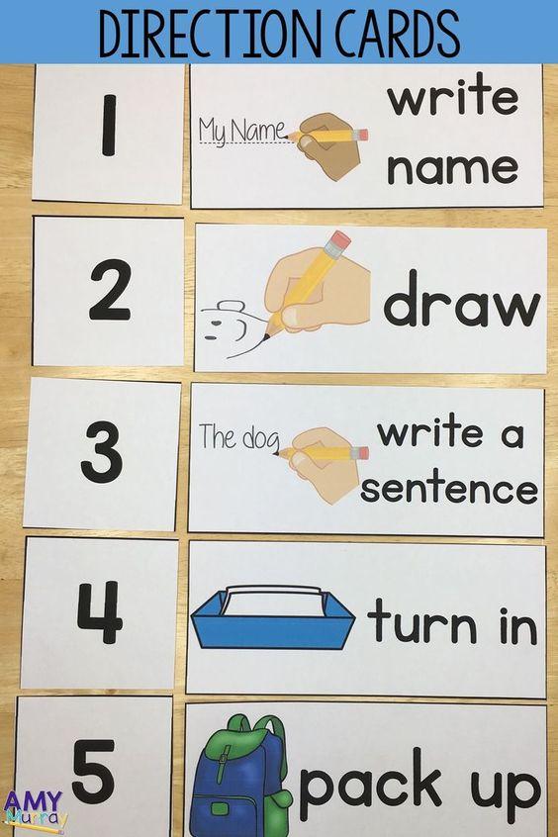

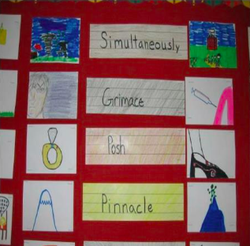
Visuals - Idea Share
Color coding
Anchor charts
Posters
Manipulatives
Labeling
Interactive Word Walls

Slide 4
2. Build in More Group Work
Engage students peer to peer interactions
Less teacher led, more student led
Provides a comfortable low risk setting to practice English

Slide 5
Grouping Ideas
Pairings with matching manipulatives or color coding
Heterogeneous ability groupings
Matching social interests
Pairing ELL students with the same native language (conferring)
What works for you?

Slide 6
3. Communicate with ESL Teacher
Co-plan for lessons
Ask to become lesson pals
Share what your working on so they can support you
Ask questions
Reach out for help
ELL teachers may have background knowledge to share
Check for common planning time

Slide 7
4. Respect the Silent Period
Silence may be rooted in fear or nerves
Don’t force students to speak
They may be waiting until they feel comfortable, they want to get it right
Share stories and ideas

Slide 8
5. Allow Some Scaffolding With The Native Language
Use their home language to learn English
Let them ask questions in their own language first
Download Google translate
Allow them to write in their first language to get their ideas down
Translate documents
Share stories and ideas

Slide 9
6. Understanding our ELL population
Understand your district data, (Bilingual waiver)
Learn about and allow for focus on student strengths
WIDA Access Scores on Genesis
Consult the WIDA Can Do Descriptors
Hit the Ground Running:
  Student Search of Access scores for one student
  Identify WIDA Can Do’s for one of your students

Slide 10
7. Ways To Promote English
Conversational Skills
Use sentence frames to identify missing vocabulary you want students to use
Use sentence stems or prompts to get students started with speaking or writing
Question starters
Daily conversation stems
Peer Conversation stems
Response starters
Notebook entry starters
Picture Prompts
Academic Vocabulary (Subject Matter)

Slide 11
8. Pre-Teach Whenever Possible
Flipped classroom
Give article in advance
Share video in advance
Give the ELL students resources in advance to pre-learn/preview about the topic

Slide 12
9. Learn About The Cultural Background Of Your Students
Learn how to pronounce their name correctly
Learn about exactly where they are from without generalizations
Familiarize yourself with students culture and customs as this will give insights into social norms, student interactions, and individual needs

Slide 13
10. Building Respectful Relationships
Foster an environment where mistakes are accepted as the learning process
Take risks as the teacher to learn a few helpful words and phrases in the student home language to support them
Encourage all students to work with and assist ELL peers.
our office

Slide 14

11. Communication
Use clear, concise language when communicating
Adjust pacing of speech to meet your students needs
Repeat or Rephrase
Correct content and not be nit-picky with too many corrections (allow for some errors such as mispronunciations)
Create opportunities for success
Praise achievements

Slide 15
12. Classroom Management
Seat ELL students where they can see and hear well ensuring they have maximum access to instruction
Assign a peer partner who speaks the same language or a talkative student

Slide 16
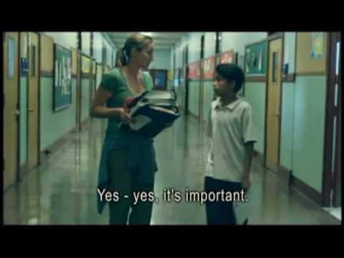
Immersion Video
Using the strategies we learned today, How would you assist Moises in the classroom?

Slide 17
Write down two truths you learned today.
Turn and Talk
Share

Slide 18
Share Out Resources

Slide 19
THANKS!
Any questions?

Slide 20
References
Gonzalez, Jennifer (2014) 12 Ways to Support English Learners in the Mainstream Classroom, https://www.cultofpedagogy.com/supporting-esl-students-mainstream-classroom/

